Slide 1


Introduction to practical disease modeling
Matt Denwood
Carsten Kirkeby
Victoria Brookes
Michael Ward

Slide 2
Outline
Introduction of the teachers
Aims and expectations
Focus
Structure
Quick presentation round

Slide 3
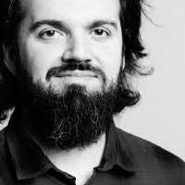
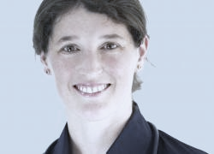
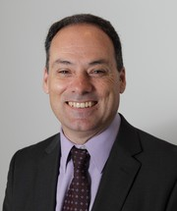
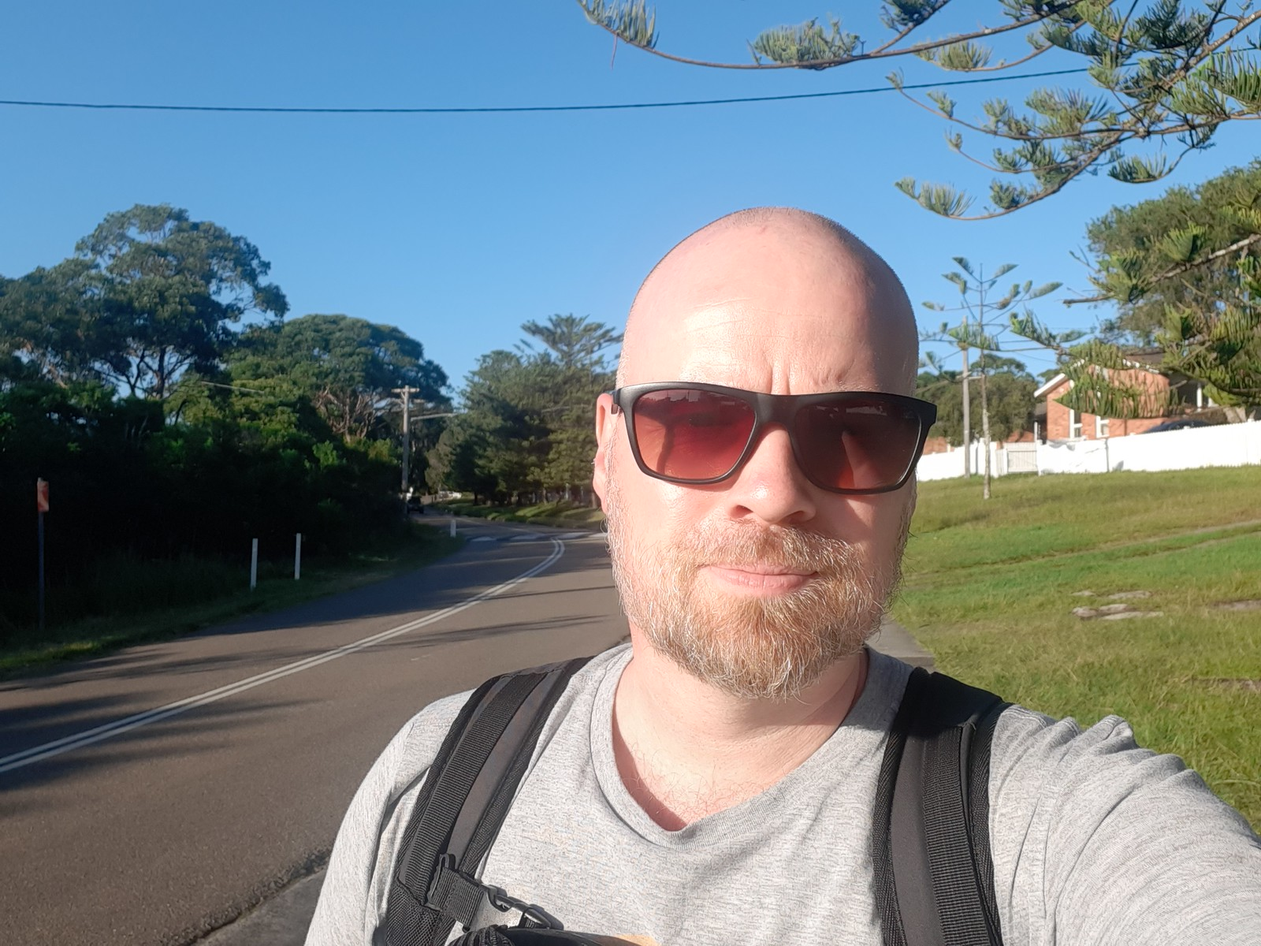
Who are we?
Victoria Brookes: Vet
Matt Denwood: Vet
Carsten Kirkeby: Biologist
Michael Ward: Vet

Slide 4
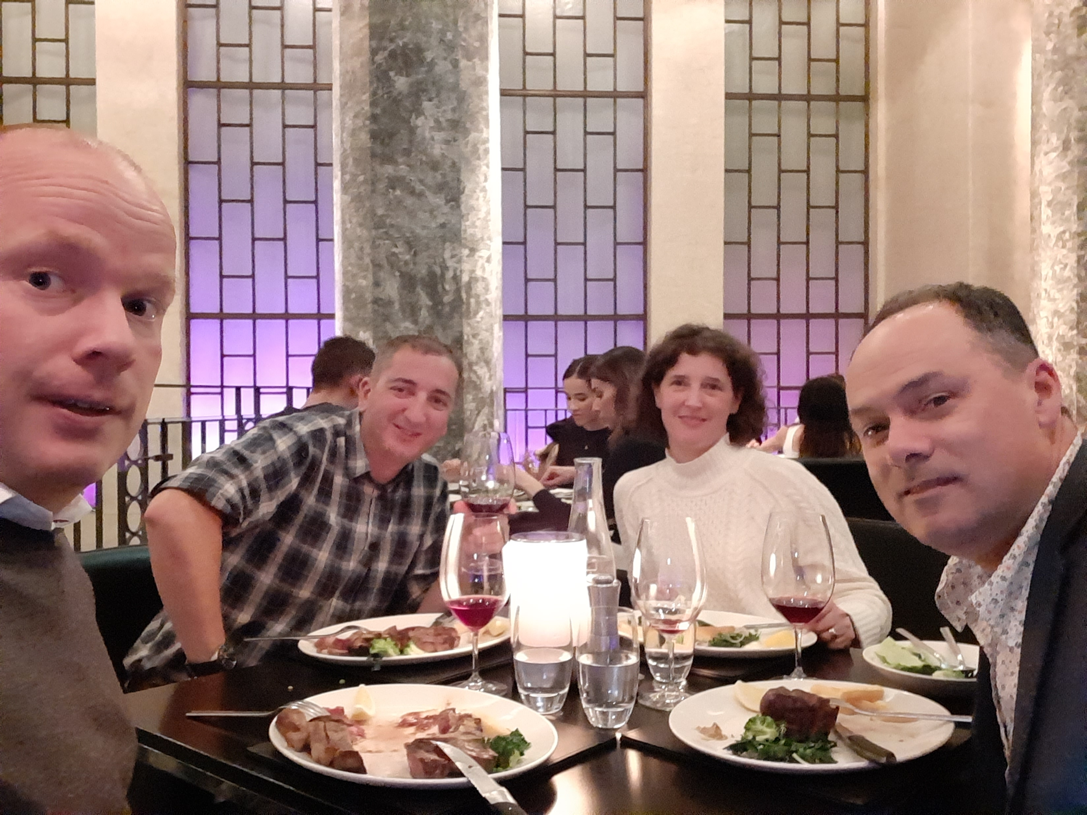

Slide 5
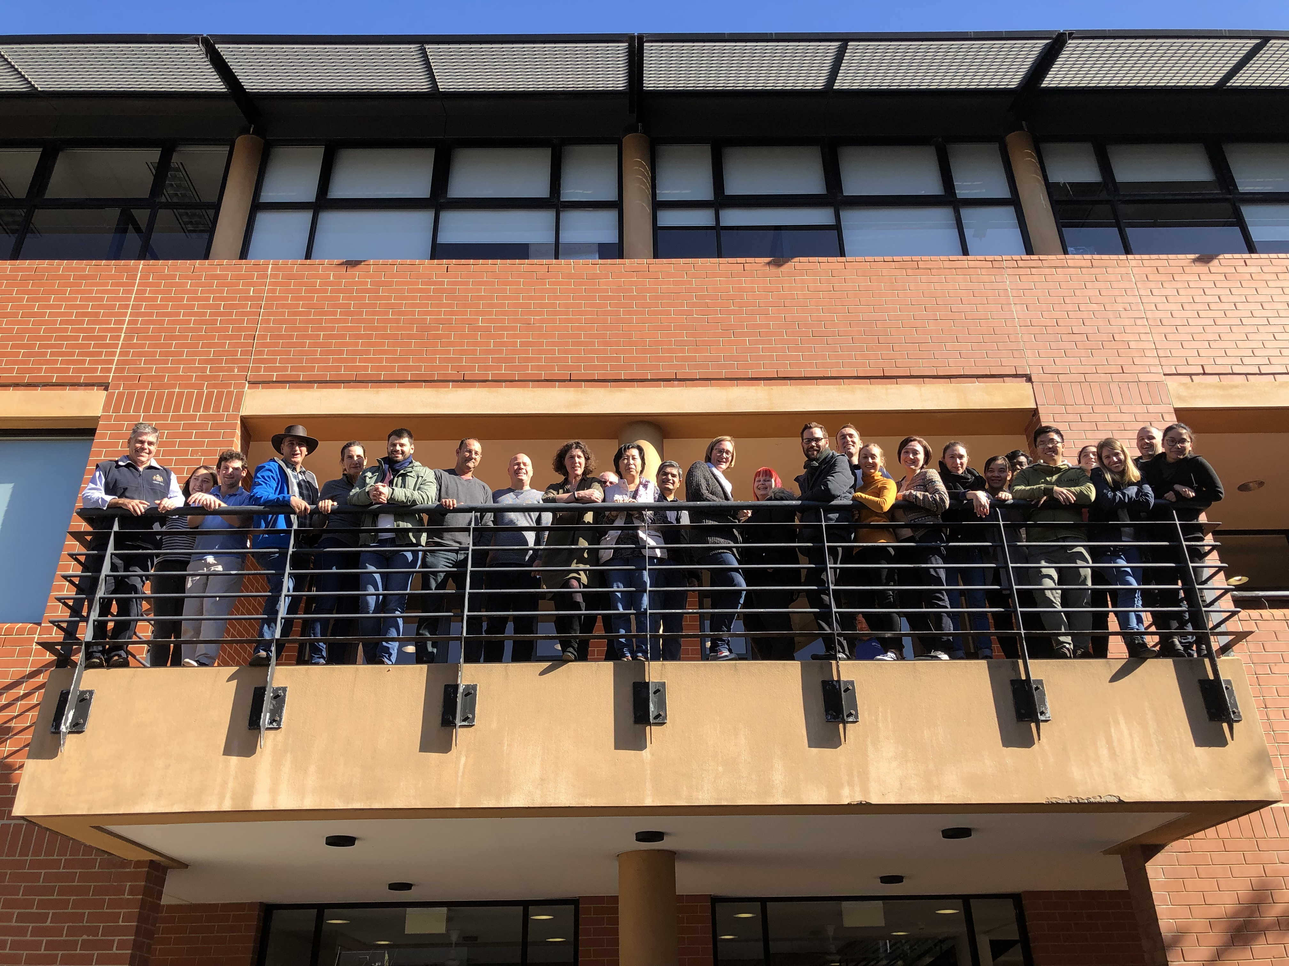

Slide 6
Aims for the course
Understand infectious disease principles relevant to disease modelling
Construct a simple dynamic model
Determine model characteristics and requirements for validation
Evaluate models and model output – be a critical consumer
Be able to use the model to investigate a research question

Slide 7
Course focus
We will focus on mechanistic models – but the concept can be utilized in other models as well
What is a mechanistic model?

Slide 8
Mechanistic model
Mathematical representation of a system – here a population with some disease spreading between individuals
Transmission of disease is simulated (in time steps) between the individuals in the population
Allow for detailed information for each individual

Slide 9
Course plan (+/-)
Day | Time | Activity/Contents | Details
1 | 8:30-09:00 | Welcome presentation Aim Plan | Powerpoint presentation
 | 09:00-10:00 | Session 1: Introduction to simulation modelling I SIR models Structure Model building steps | Powerpoint presentation + Hands-on exercises
 | 10:00-10:30 | Break
 | 10:30-12:00 | Exercise 1 | Hands-on exercises
 | 12:00-13:00 | Lunch break
 | 13:00-14:00 | Session 2: Introduction to simulation modelling II Model expansions Simulation over time Mixing Transmission | Powerpoint presentation
 | 14:00-14:30 | Break
 | 14:30-17:00 | Exercise 2 | Hands-on exercises
Day | Time | Activity/Contents | Details
2 | 8:30-10:00 | Catch up, questions and exercise solutions from Day 1 | Powerpoint presentation
 | 10:00-10:30 | Break
 | 10:30-12:00 | Exercise 3 (group work) | Exercises
 | 12:00-13:00 | Lunch break
 | 13:00-14:30 | Exercise 3 (group work, continued) | Hands-on exercises
 | 14:30-15:00 | Break
 | 15:00-16:00 | Group presentations and wrap up | Hands-on exercises

Slide 10
Quick presentation round
Who you are you?
What do you do?
What coding experience do you have?
Why do you join this course? (motivation)
What are your expectations from the course?

Slide 11
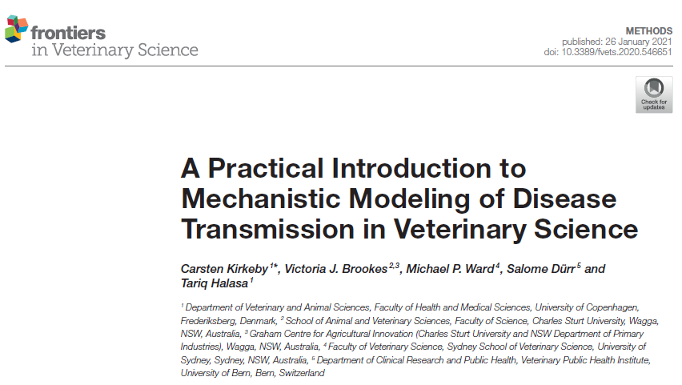
Let´s begin!

Slide 12




Let´s begin!

Slide 13

Let´s begin!
(Please ask questions along the way)

